Slide 1

DESIGN AND FABRICATION OF REAL TIME RAILWAY INSPECTION SYSTEM USING IOT
Under the esteemed guidance of
D. Raja Ramesh M.Tech ,(Ph.D)
Assistant Professor, ECE
Presented by
K. Hari Krishna(15331A0475)
N. Vishnu Teja(15331A04A9)
P. Madhuri(15331A04B9)
Ch. Greeshant(16335A0413)

Slide 2
PRESENTATION OUTLINE
Abstract
Literature survey
Block diagram
Components specification
Installation and configuration of Blynk application
Working
Conclusion
References

Slide 3
Abstract
India has one of the world's largest railway networks, manual Inspection and detecting a crack on these railways tracks is very tedious process and consumes lot of time and human resource. The project aims in designing railway track crack detection autonomous vehicle using Microcontroller, IR obstacle sensors assembly system, which detects the cracks along its path, picks up the obstacles on the path, and it is able to remove small plastic wastes with the help of a suction mechanism; the vehicle is also capable of monitoring the location of the crack by using the GPS module and alerts through messages with the help of Node MCU module by interfacing with Google API. The central component of the whole system is a Node MCU. The vehicle is powered with the help of Solar panel and Lead Acid battery assembly. The vehicle moves along the path of railway track and IR obstacle sensors mounted on the vehicle front end inspecting the track along its path. When any crack or deformation is detected on the track the vehicle stops and the location of the crack is identified and the location Latitude and Longitude coordinates are procured using the node MCU module using Google API and it is used to send these Location coordinates in the form of messages to the pre-defined number.

Slide 4
Literature Survey
The previously existing project employed a GSM module for communication which limits the range of operation.
It also employed a fixed power source which limited the time of operation.
Addressing those two problems this project uses an built in IOT module and solar, mechanical power harvesters that overcome the range, duration of operation.
In addition to this, a suction and watering mechanism is also being employed.

Slide 5
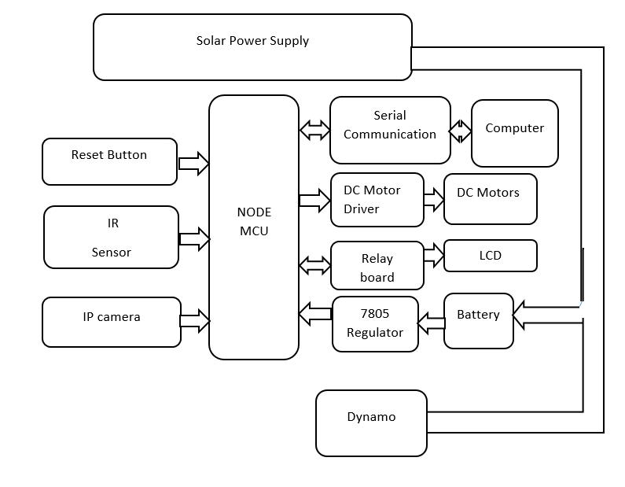
Block diagram
Fig: Block diagram of railway inspection robot

Slide 6
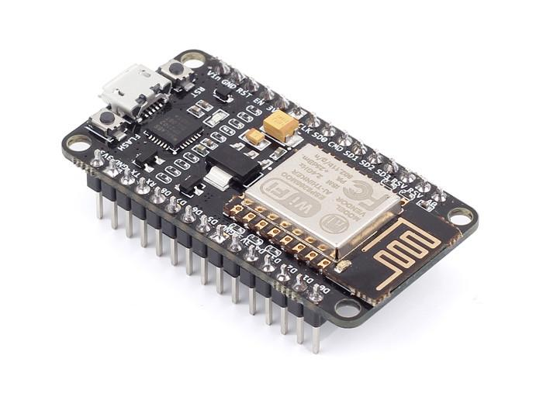
Components specification
Node MCU
NodeMCU is an open source Lua based firmware for the ESP8266 WiFi SOC from Expressif and uses an on-module flash-based SPIFFS file system.
Features:
Open-source
Interactive
Programmable
Low cost
Simple
Smart
WI-FI enabled with inbuilt or on board
The Development Kit based on ESP8266, integrates GPIO, PWM, IIC, 1-Wire and ADC all in one board.
Fig: Node MCU

Slide 7
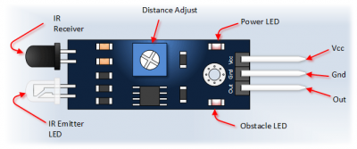
IR sensor
The principle of an IR sensor working as an Object Detection Sensor can be explained using the following figure. An IR sensor consists of an IR LED and an IR Photodiode; together they are called as Photo – Coupler or Opto – Coupler.
When the IR transmitter emits radiation, it reaches the object and some of the radiation reflects back to the IR receiver. Based on the intensity of the reception by the IR receiver, the output of the sensor is defined.
Fig: Ultra Sonic Sensor

Slide 8
Motors
This project employs various kinds of motors for it’s operation. They are,
Centre shafted motors
Side shafted motors
Gripper motor
Suction motor

Slide 9
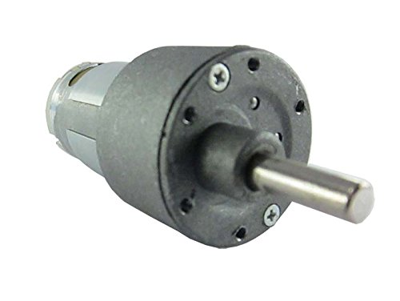
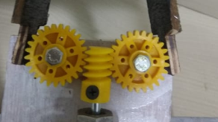
Side shafted motor
One of the side shafted motor is a 60 rpm 5kg Johnson motor. It is for the running of Spur gear and worm gear.
It is a simple DC motor featuring metal gearbox for driving the shaft of the motor, so it is a mechanically commutated electric motor which is powered from DC supply.
Worm Gear
T = F * r
Spur Gear
Fig: Side shafted Johnson motor
Fig: Gears

Slide 10
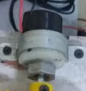
Gripper and suction motors
It works on DC Motor (9 to 12V DC). Change in rotation direction of the DC Motor, generates Jaw Open & Close Action.
The DC motor can be easily be controlled with the help of a microcontroller along with L293D Motor Driver module.
Fig: Gripper motor

Slide 11
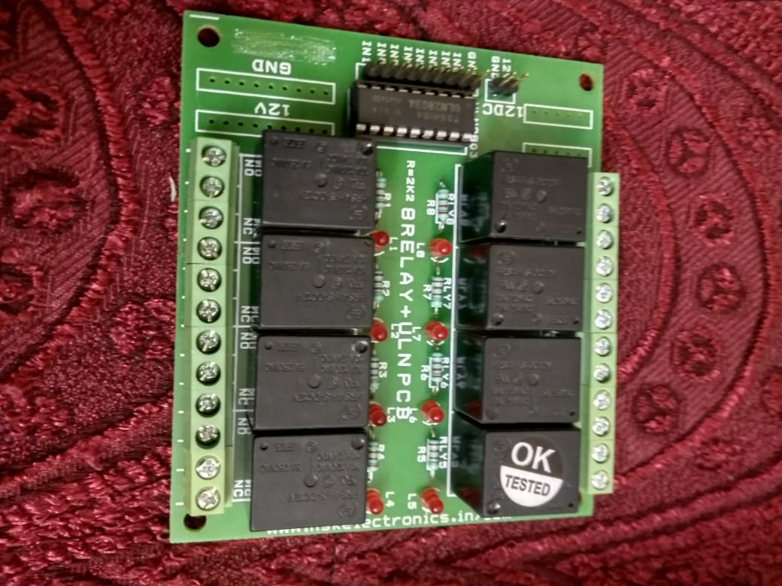
Relay Board
Relays are suitable for driving high power electronic devices such as lights, motors, electric fans and air condition.
A relay can be used to control high voltages with a low voltage by connecting it to an MCU.
The IC ULN2003 which is present on the relay board is used to protect all the relays. If there is any damage we can replace the single IC but not the overall circuit.
Fig: Relay board

Slide 12
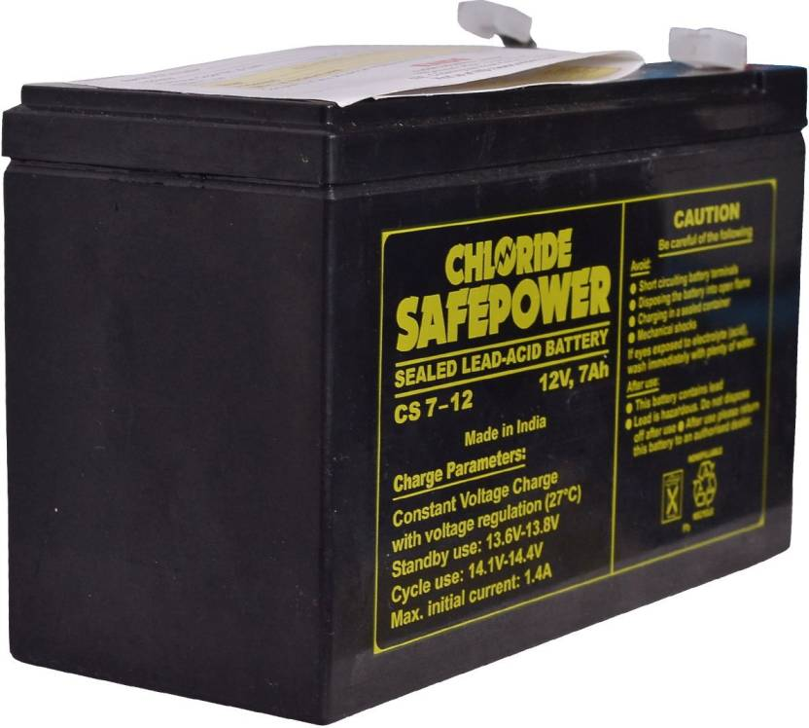
Battery
Specifications:
Input Voltage 12V
Output Voltage 14.4V
Output Power Wattage 86.4W
Fig: Battery

Slide 13
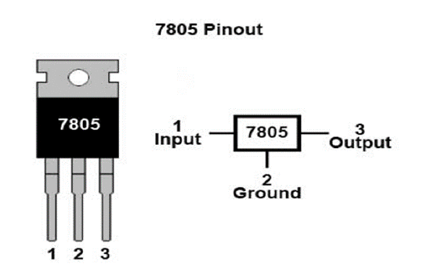
7805IC Voltage Regulator
7805 is a three terminal linear voltage regulator IC with a fixed output voltage of 5V which is useful in a wide range of applications.
It can deliver up to 1.5 A of current (with heat sink).
Has both internal current limiting and thermal shutdown features.
Requires very minimum external components to fully function.

Slide 14
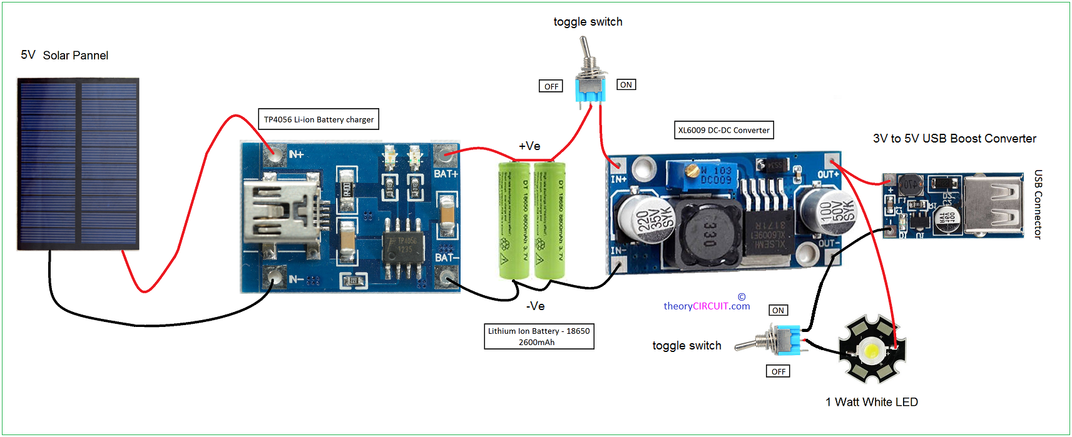
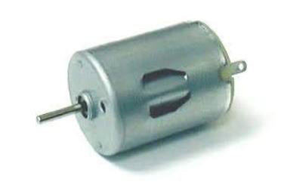
Solar Power Harvesting:
Power Supply
In this project 3 solar panels of 12W each is combinedly used to power the robot.
A 12V, 7Ah battery will be charged continuously using this method of solar harvesting.
M2E Power Harvesting:
A dynamo is used in this project to convert the mechanical energy generated from the movement of the robot into electrical energy.
Fig: Solar Power Supply
Fig: Dynamo

Slide 15
Installation and configuration of Blynk application
Firstly install “Blynk” application from play-store and open it.
Create an account by using Email account or Facebook account.
Click on New Project, enter the Project Name (Name can be of any thing based on the users wish) as “Home Automation“, Choose Device as “NodeMCU“, Connection Type as “Wi-Fi” and then click “Create” icon.
After the creation of Project, App will send the Auth Token code to registered Email ID.
Click on the “+” icon which located on top right side of the app to create buttons.
Enter the button name and select the GPIO pins.

Slide 16
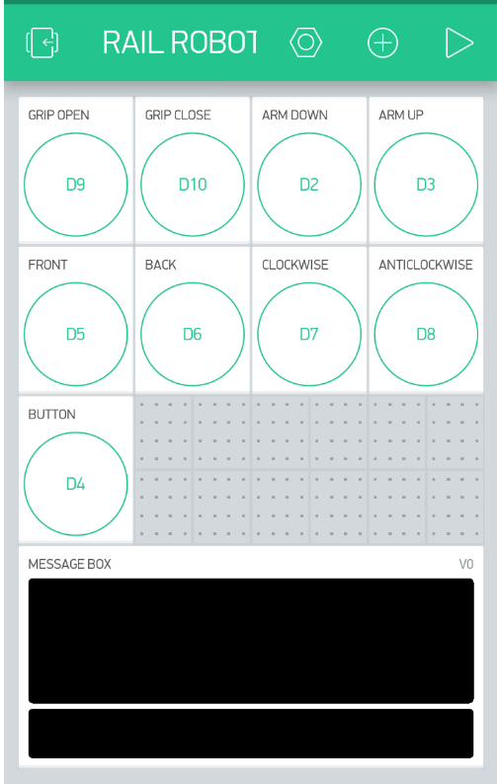
Blynk software

Slide 17
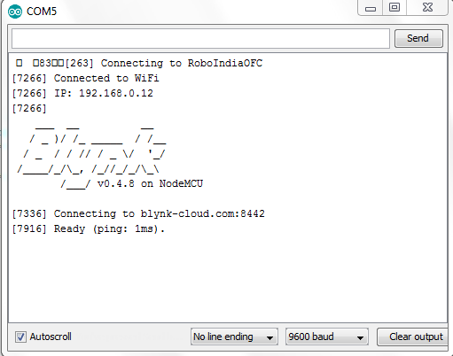
Verification of Connection of Blynk to WiFi

Slide 18
Working
Crack detection:
1) When the vehicle is Powered On, it moves along the model track. The Ultrasonic sensors monitors the condition of the tracks.
2)The motor operations of two motors can be controlled by input logic at pins 2 & 7 and 10 & 15.Input logic 00 or 11 will stop the corresponding motor. Logic 01 and 10 will rotate it in clockwise and anti-clock wise directions, respectively.
3)Enable pins 1 and 9 (corresponding to the two motors) must be high for motors to start operating. When an enable input is high, the associated driver gets enabled. As a result, the outputs become active and work in phase with their inputs. Similarly, when the enable input is low, that driver is disabled, and their outputs are off and in the high-impedance state.

Slide 19
GPS tracking:
4) When a crack is detected by the Ultrasonic sensor the vehicle stops at once, and the GPS receiver triangulates the position of the vehicle to receive the Latitude and Longitude coordinates of the vehicle position, from satellites.
5) The Latitude and Longitude coordinates received by GPS are converted into a text message which is done by PIC microcontroller.
6) The Iot module sends the text message to the computer that is Inserted into the robot.
7) Once the message has been successfully sent to the number, the vehicle resumes its movement forward depending on the type of crack.

Slide 20
Obstacle picking & Suction:
8) The obstacles on the railway track are detected and picked aside with the help of a robotic arm which uses a side shafted dc Johnson motor for the base of the arm and a centre shafted dc motor for gripper.
9) Wastes on the track are removed using a suction motor.
Real time monitoring:
10) The operations of the vehicle can be remotely controlled with the help of a IOT module and a camera section.

Slide 21
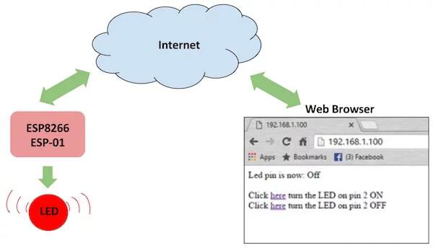
Fig: Connection via Internet

Slide 22
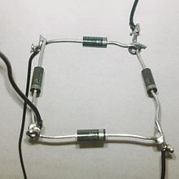
Bridge diode connection :
11) Here, a bridge diode circuit is used for collecting both positive power from the solar panel and the negative power from the solar panel. By using this connection, more power can be stored.
12) While the day time the power consumed by this robot is negligible. Since the input from solar and dynamo is equal to the power consumed for the moment of the robot.
Fig: Bridge diode circuit

Slide 23
Applications
Crack detection
Pick and place robotic arm
Tracking of the vehicle
Solar Power Harvesting
M2E Power Harvesting
Suction
Real time monitoring using IOT
Watering

Slide 24
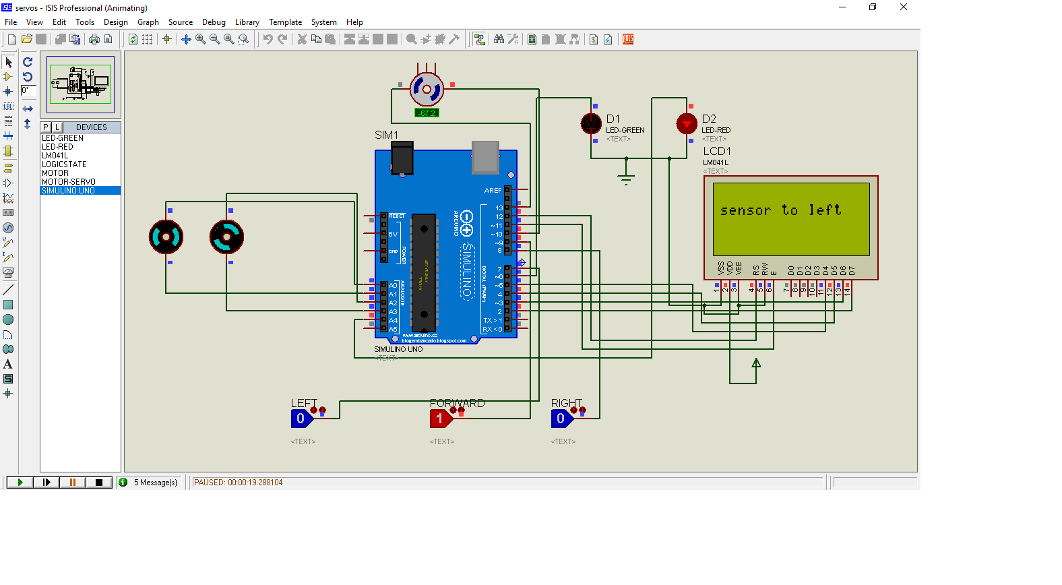
Results
Simulation results of the chassis motors
Fig: Snapshot of Simulation

Slide 25
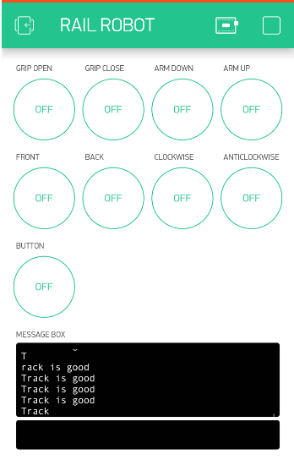
When there is no fault on the railway track

Slide 26
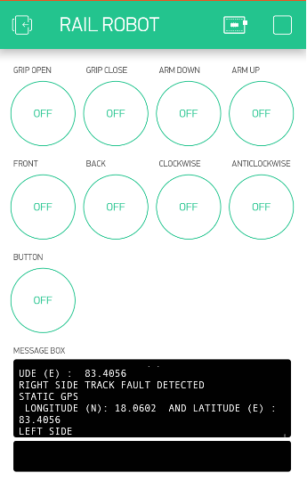
When there is a crack on the right side of the track

Slide 27
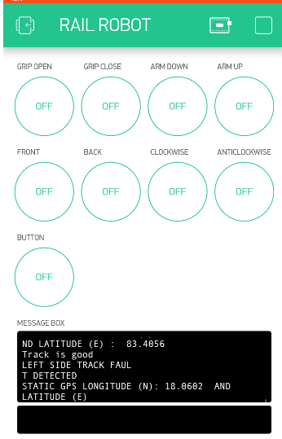
When there is a crack on the left side of the track

Slide 28
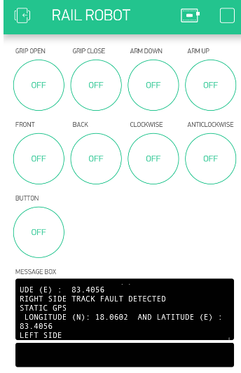
When there is cracks on both sides of the track

Slide 29
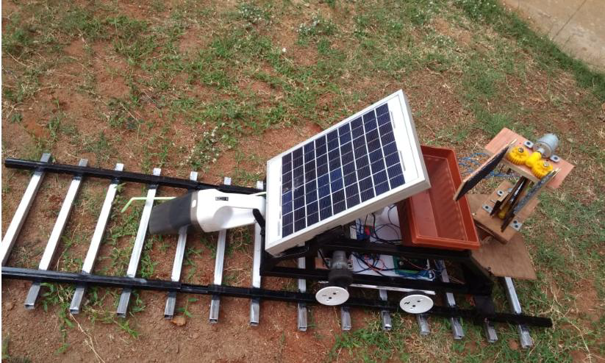
Final design of the railway inspection system

Slide 30
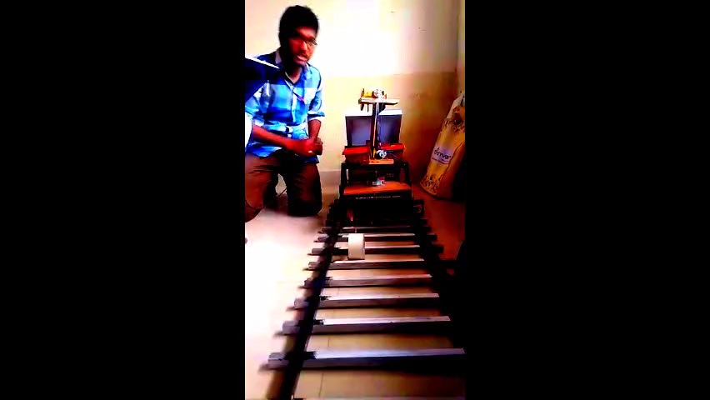
Demo of the project

Slide 31
REFERENCES
[1] Manoj Hedaoo, Suchita Hirde, Arshi Khan, "Sanitation in indian railway premises: a great cause of concern", International Journal of Advanced Engineering Technology, 2015.
[2] Yuvashree G, S. Murugappriya“Railway track inspection system for rail bolt and crack fault detection” International Journal of Electrical and Electronics Engineers ISSN- 23212055 (E) IJEEE, Volume 07, Issue 01, Jan- June 2015.
[3] Manoj Hedaoo, Suchita Hirde, Arshi Khan, "Sanitation in indian railway premises: a great cause of concern", International Journal of Advanced Engineering Technology, 2015.
[4] Apr-May 2014, ISSN: 2320 – 8791, Innovative Railway Track Surveying With Sensors and Controlled By Wireless Communication by Athira Ajith 1, Aswathy K S2, Binoy Kumar H3, Dantis Davis4, Laksh
[5] Manoj Hedaoo, Suchita Hirde, Arshi Khan, "Sanitation in indian railway premises: a great cause of concern", International Journal of Advanced Engineering Technology, 2015. mi S Pai5, Janahanlal P Stephen.

Slide 32
Thank you

